Slide 1
Object Localization and Detection

Slide 2
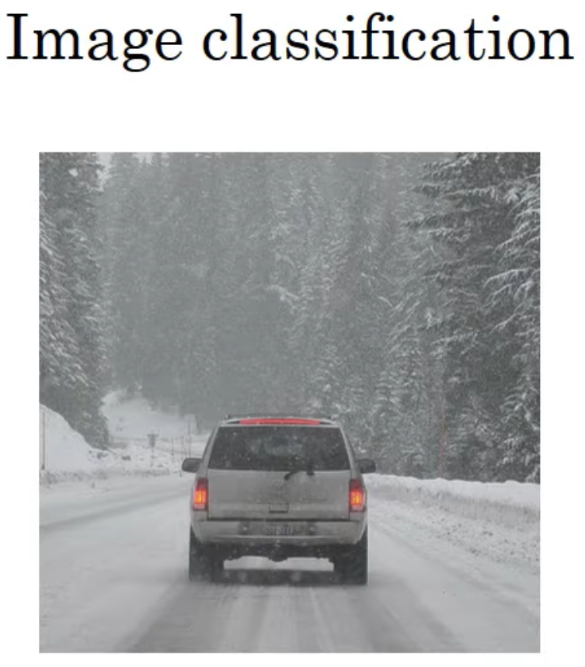
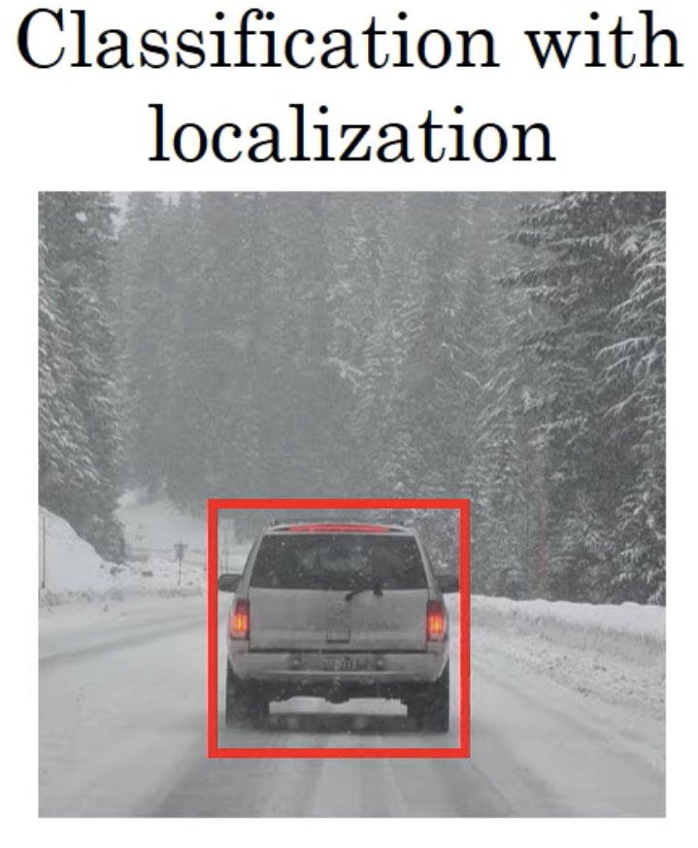
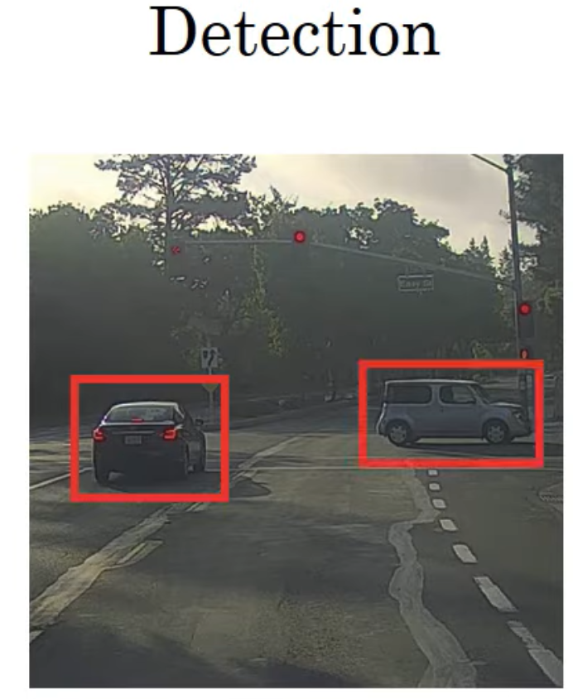
Car
Car+bounding box
Multiple object/
bounding box

Slide 3
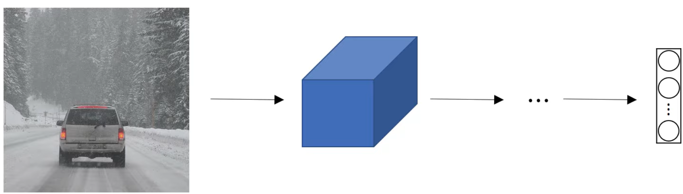






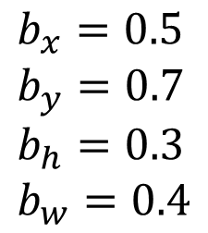
Classification with localization
$$(0,0)$$
Soft-max
a
b
c
d
$$(1,1)$$
$$b_{x}=0.5 \\ b_{y}=0.7 \\ b_{h}=0.3 \\ b_{w}=0.4$$
$$b_{x},b_{y},b_{h},b_{w}$$
.
$$b_{w}$$
Pedestrian
Car
Bike
Background
$$b_{h}$$
$${(b}_{x},b_{y})$$

Slide 4
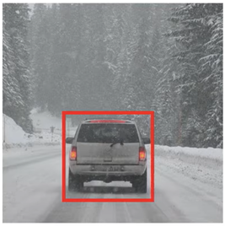
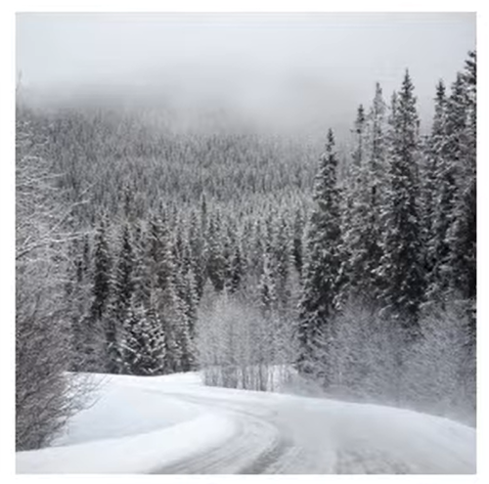
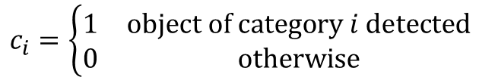

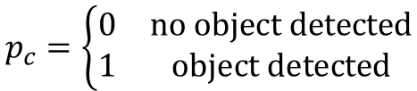

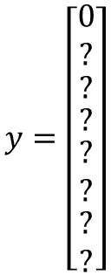
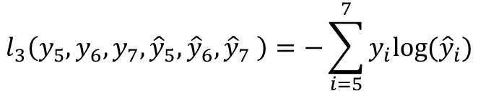
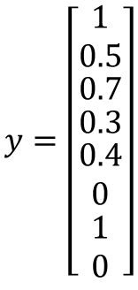
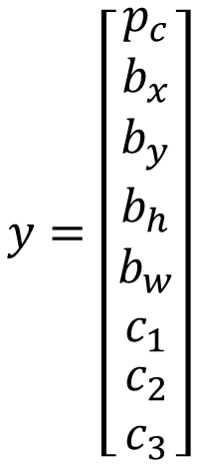
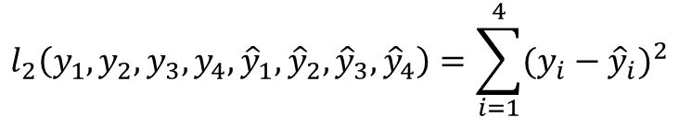
Defining the target label
$$y=\left[\begin{matrix}\begin{matrix}p_{c} \\ b_{x}\end{matrix} \\ \begin{matrix}b_{y} \\ \begin{matrix}b_{h} \\ \begin{matrix}b_{w} \\ c_{1} \\ \begin{matrix}c_{2} \\ c_{3}\end{matrix}\end{matrix}\end{matrix}\end{matrix}\end{matrix}\right]$$
$$\begin{matrix}\begin{matrix}y_{0} \\ y_{1} \\ y_{2}\end{matrix} \\ \begin{matrix}y_{3} \\ y_{4} \\ \begin{matrix}y_{5} \\ y_{6} \\ y_{7}\end{matrix}\end{matrix}\end{matrix}$$
$$p_{c}=\left\{\begin{matrix}0 & \text{no} \text{object} \text{detected} \\ 1 & \text{object} \text{detected}\end{matrix}\right.$$
car
background
$$c_{i}=\left\{\begin{matrix}1 & \text{object} \text{of} \text{category} i \text{detected} \\ 0 & \text{otherwise}\end{matrix}\right.$$
$$ℓ\left(y,\hat{y}\right)=l_{1}\left( \right)+l_{2}\left( \right)+l_{3}( )$$
$$y=\left[\begin{matrix}\begin{matrix}1 \\ 0.5\end{matrix} \\ \begin{matrix}0.7 \\ \begin{matrix}0.3 \\ \begin{matrix}0.4 \\ 0 \\ \begin{matrix}1 \\ 0\end{matrix}\end{matrix}\end{matrix}\end{matrix}\end{matrix}\right]$$
$$y=\left[\begin{matrix}\begin{matrix}0 \\ ?\end{matrix} \\ \begin{matrix}? \\ \begin{matrix}? \\ \begin{matrix}? \\ ? \\ \begin{matrix}? \\ ?\end{matrix}\end{matrix}\end{matrix}\end{matrix}\end{matrix}\right]$$
Loss functions
$$l_{1}\left(y_{0},{\hat{y}}_{0}\right)=−y_{0}\log\left({\hat{y}}_{0}\right)−\left(1−y_{0}\right)log⁡(1−{\hat{y}}_{0})$$
binary cross-entropy
$$l_{2}\left(y_{1},y_{2},y_{3},y_{4},{\hat{y}}_{1},{\hat{y}}_{2},{\hat{y}}_{3},{\hat{y}}_{4}\right)=\sum_{i=1}^{4}{{(y_{i}−{\hat{y}}_{i})}^{2}}$$
quadratic
$$l_{3}\left(y_{5},y_{6},y_{7}, {\hat{y}}_{5},{\hat{y}}_{6},{\hat{y}}_{7} \right)=−\sum_{i=5}^{7}{y_{i}log⁡({\hat{y}}_{i})}$$
soft-max cross-entropy
?=don’t care

Slide 5
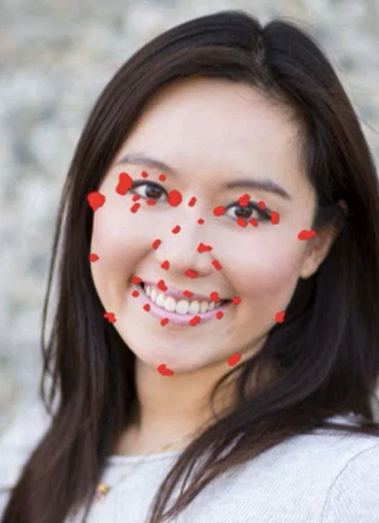
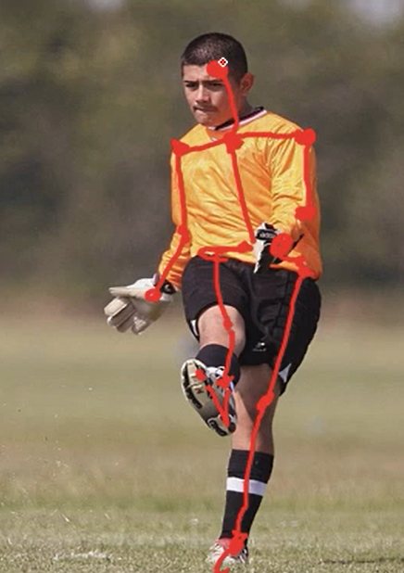

Landmark detection
Detecting several points (landmarks) with coordinates $(l_{ix,}l_{iy})$
E.g.: the borders of the mouth, the corners of the yes, etc…
Useful to recognize emotions, postures, etc…
The CNN should have a final layer with a possible softmax (for classification – e.g. it is a face or not) and a set of coordinate pairs

Slide 6
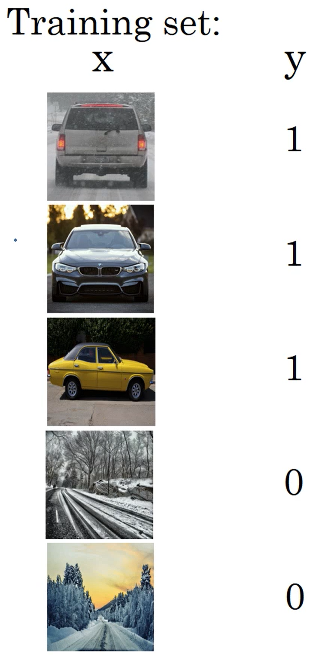
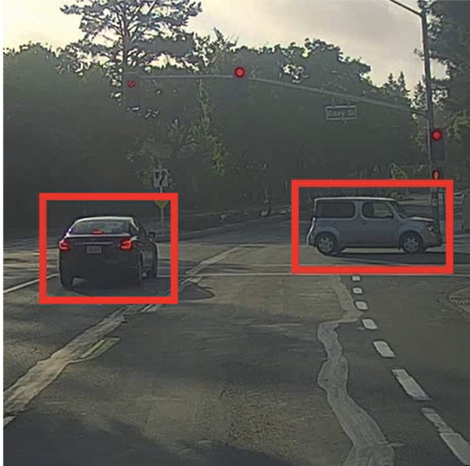
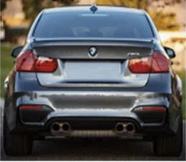
(Object) Detection
Task: learn a CNN such as:
→ CNN → y

Slide 7
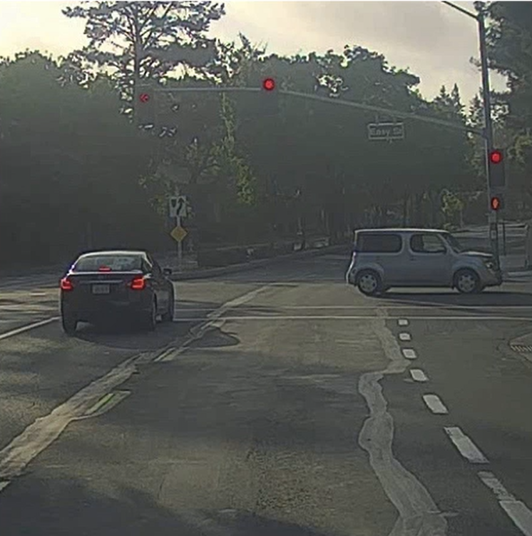
Sliding window detection
0
0
0
Having to define a given stride and
a given window size
Usual approach:
  fix a given stride and
  repeat the task several times
  with several different windows sizes
Main issue: computational cost
Big stride → less cost, but smaller probability
of detecting target object
1
SOLUTION: Implementing sliding window convolutionally
NB: if we need to localize the object, we can output the bounding
boxes of the corresponding window
Task: detect cars

Slide 8
Convolutional sliding window

Slide 9
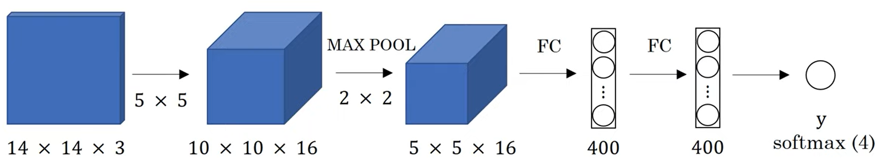
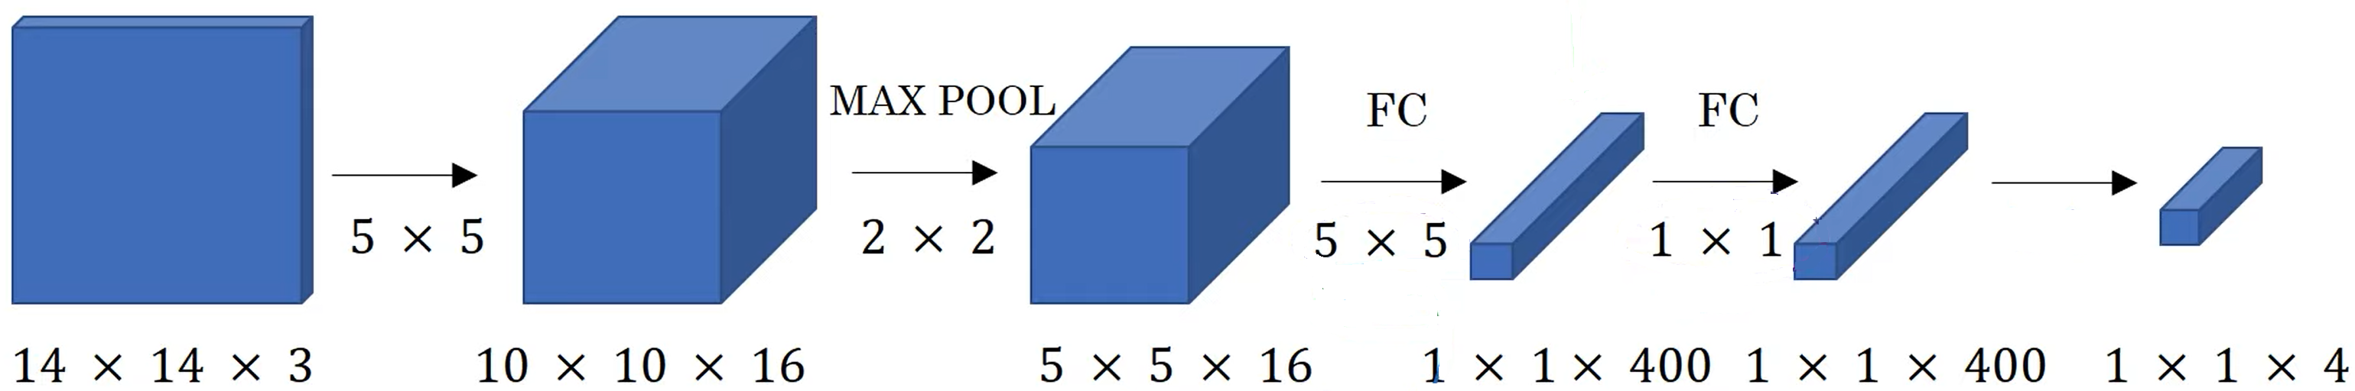

Turning FC layers into convolutional layers
400 filters
400 filters
4 filters
Notes:
s=1 per conv s=2 per max-pool as usual

Slide 10
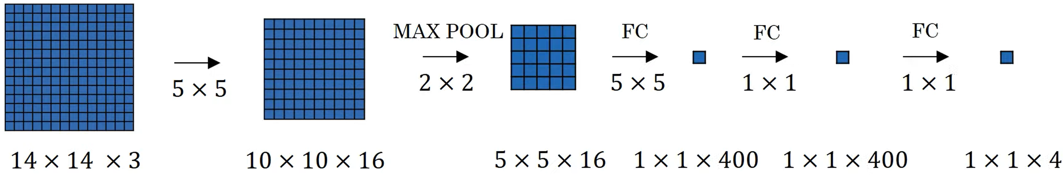
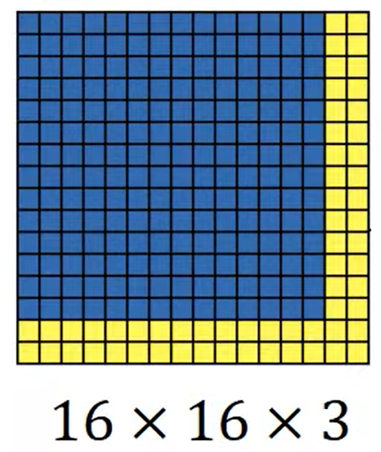
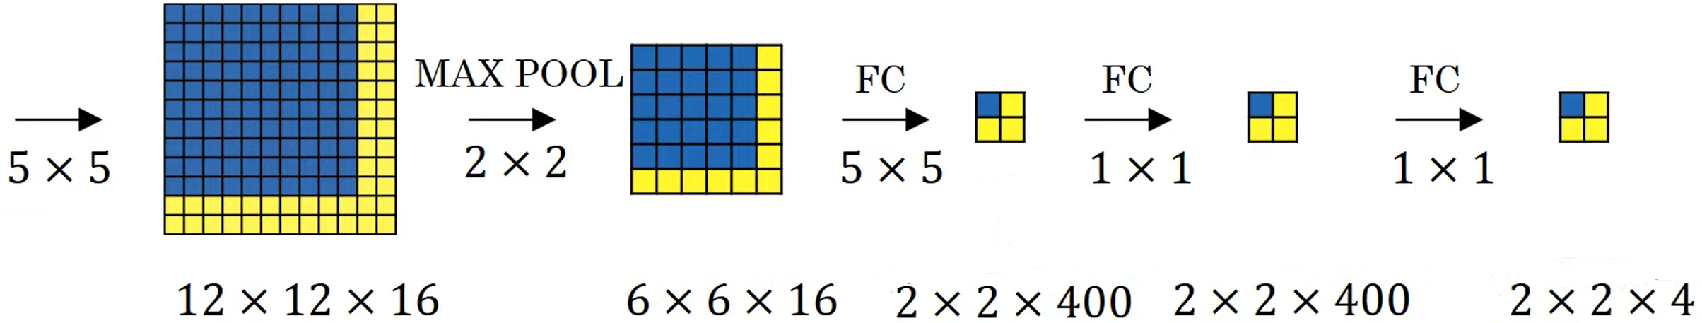
Conv implementation of sliding windows
Let’s Ignore depth
Training
Test
The blue area is like sliding the window
of the training image on the set image

Slide 11
The size of the input layer in the training CNN is the windows size
The stride of the MAX-POOL layer is the stride of the sliding window
After the MAX-POOL the filter size should be set in order to produce 1x1 output

Slide 12
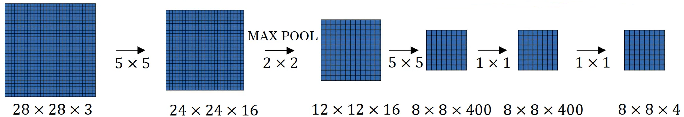
Another example
Max-pool stride s=2

Slide 13
Sliding window 8x8 with stride s=1
$$8×8×3\underset{→}{5×5}4×4×16\underset{→}{\begin{aligned}\text{M}\text{AX}\text{−}\text{POOL} \\ 2×2 \\ s=1\end{aligned}}3×3×16\underset{→}{3×3}1×1×400\underset{→}{1×1}1×1×400\underset{→}{1×1}1×1×4$$
Test
$$28×28×3\underset{→}{5×5}24×24×16\underset{→}{\begin{aligned}\text{M}\text{AX}\text{−}\text{POOL} \\ 2×2 \\ s=1\end{aligned}}23×23×16\underset{→}{3×3}21×21×400\underset{→}{1×1}21×21×400\underset{→}{1×1}21×21×4$$
Image 28x28 with filter of 8x8 and stride 1 → final output 21x21 regions (bounding boxes) that identify 1 out of 4 objects

Slide 14
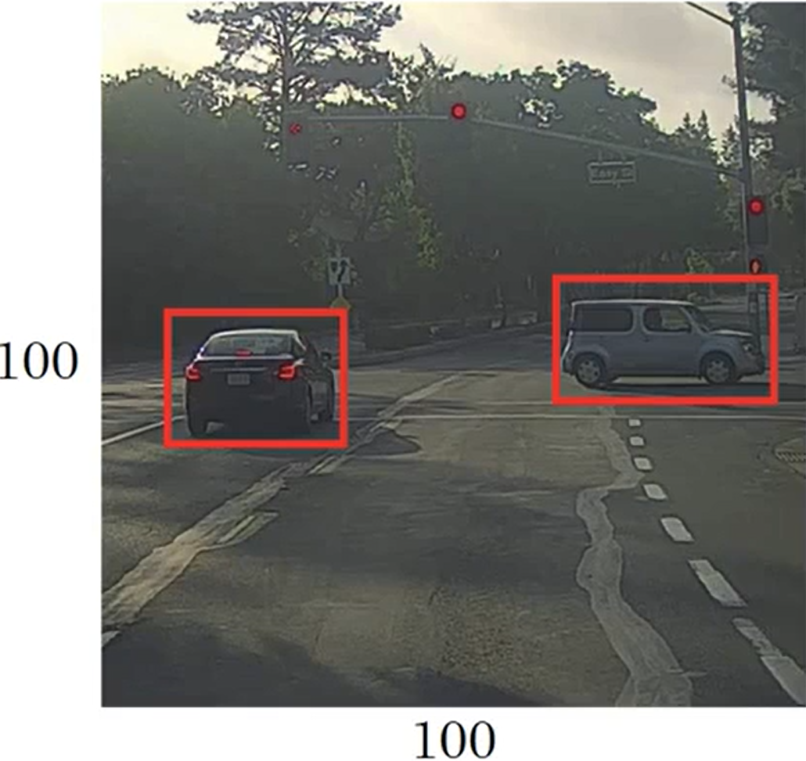
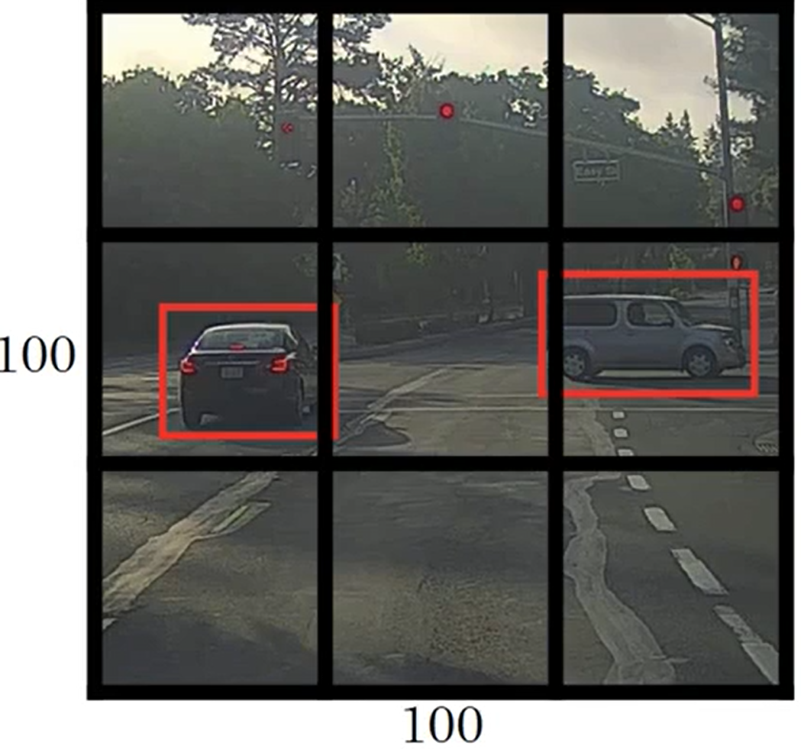

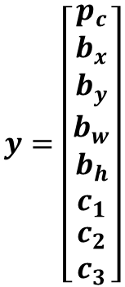
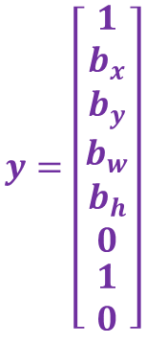

Predicting bounding box efficiently: YOLO
$$y=\left[\begin{matrix}p_{c} \\ b_{x} \\ \begin{matrix}b_{y} \\ b_{w} \\ \begin{matrix}b_{h} \\ c_{1} \\ \begin{matrix}c_{2} \\ c_{3}\end{matrix}\end{matrix}\end{matrix}\end{matrix}\right]$$
Suppose 1: pedestrian
2: car; 3:motorcycle
Training labels:
for each grid cell ➔
$$y=\left[\begin{matrix}0 \\ ? \\ \begin{matrix}? \\ ? \\ \begin{matrix}? \\ ? \\ \begin{matrix}? \\ ?\end{matrix}\end{matrix}\end{matrix}\end{matrix}\right]$$
$$y=\left[\begin{matrix}1 \\ b_{x} \\ \begin{matrix}b_{y} \\ b_{w} \\ \begin{matrix}b_{h} \\ 0 \\ \begin{matrix}1 \\ 0\end{matrix}\end{matrix}\end{matrix}\end{matrix}\right]$$
$$3×3×8 \text{labels}$$

Slide 15
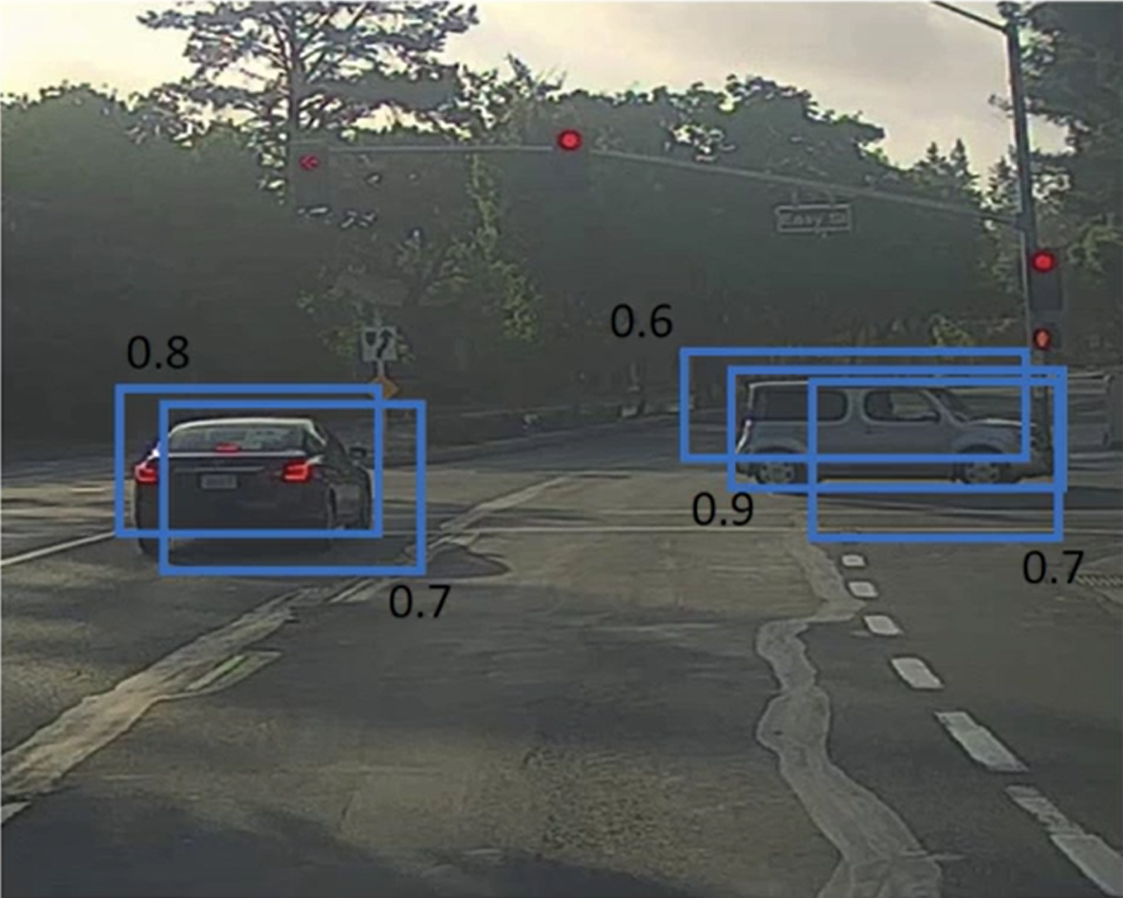
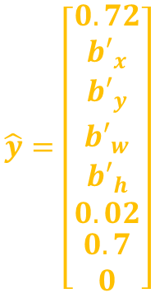
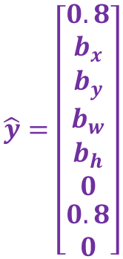
Yolo: training and testing
During training each object is assigned to only 1 cell (the one containing the object middle point)
During testing it may happen that more than a cell identifies the same object and with different bounding boxes
$$\hat{y}=\left[\begin{matrix}0.8 \\ b_{x} \\ \begin{matrix}b_{y} \\ b_{w} \\ \begin{matrix}b_{h} \\ 0 \\ \begin{matrix}0.8 \\ 0\end{matrix}\end{matrix}\end{matrix}\end{matrix}\right]$$
$$\hat{y}=\left[\begin{matrix}0.72 \\ {b′}_{x} \\ \begin{matrix}{b′}_{y} \\ {b′}_{w} \\ \begin{matrix}{b′}_{h} \\ 0.02 \\ \begin{matrix}0.7 \\ 0\end{matrix}\end{matrix}\end{matrix}\end{matrix}\right]$$

Slide 16






BB representation for each cell:
coord of middle point $b_{x},b_{y}$ wrt (0,0)
left upper cell corner
$b_{w},b_{h }$percentage of width/height of
the cell (could be >1 if bb spans over grid
cells)
$$(0,0)$$
$$b_{x},b_{y} \text{e}\text{.}\text{g}\text{ 0.7,0.6}$$
$$(1,1)$$
$$b_{h} \text{e}\text{.}\text{g}\text{. 0.65}$$
$$b_{w} \text{e}\text{.}\text{g}\text{. 0.85}$$

Slide 17

Final architecture
CNN
ConvNet
Output layer $n×n×k$
Input image
$$n×n \text{is} \text{the} \text{input} \text{grid}\text{; }k \text{is}\text{ \#}\text{object} \text{class}\text{+}4+1$$

Slide 18
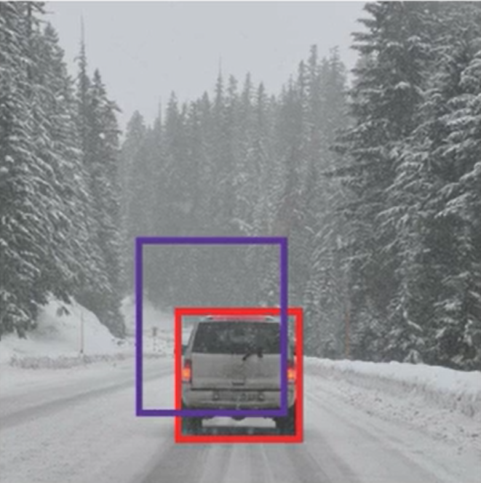
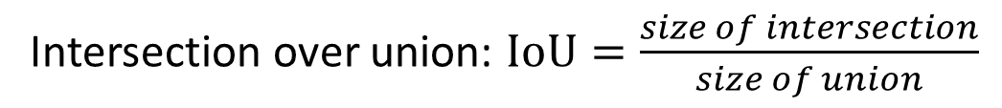

Evaluating object localization
Red is Ground true
Intersection over union: $IoU=\frac{size of intersection}{size of union}$
$$\text{Correct} \text{if} IoU≥0.5 \text{by} \text{convention}$$
How good is purple bounding box?

Slide 19
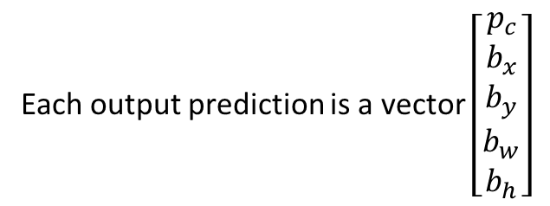
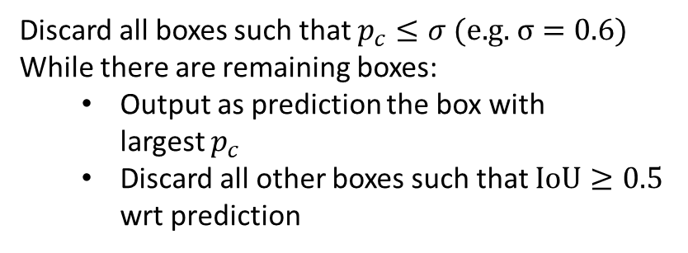
Non-max suppression
Multiple bounding box may detect the same object
(possibly with different probability)
Each output prediction is a vector $\left[\begin{matrix}p_{c} \\ \begin{matrix}b_{x} \\ b_{y} \\ \begin{matrix}b_{w} \\ b_{h}\end{matrix}\end{matrix}\end{matrix}\right]$
Discard all boxes such that $p_{c}≤σ \text{(}\text{e}\text{.}\text{g}\text{. }σ=0.6)$
While there are remaining boxes:
  Output as prediction the box with
  largest $p_{c}$
  Discard all other boxes such that $\text{IoU}≥0.5$
  wrt prediction

Slide 20





Non-max suppression
Multiple bounding box may detect the same object
(possibly with different probability)
Each output prediction is a vector $\left[\begin{matrix}p_{c} \\ \begin{matrix}b_{x} \\ b_{y} \\ \begin{matrix}b_{w} \\ b_{h}\end{matrix}\end{matrix}\end{matrix}\right]$
$$0.6$$
$$0.8$$
$$0.9$$
$$0.7$$
Discard all boxes such that $p_{c}≤σ \text{(}\text{e}\text{.}\text{g}\text{. }σ=0.6)$
While there are remaining boxes:
  Output as prediction the box with
  largest $p_{c}$
  Discard all other boxes such that $\text{IoU}≥0.5$
  wrt prediction
$$0.7$$

Slide 21
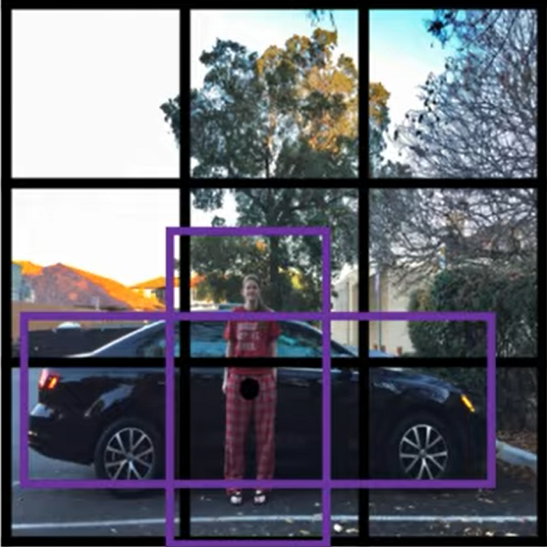
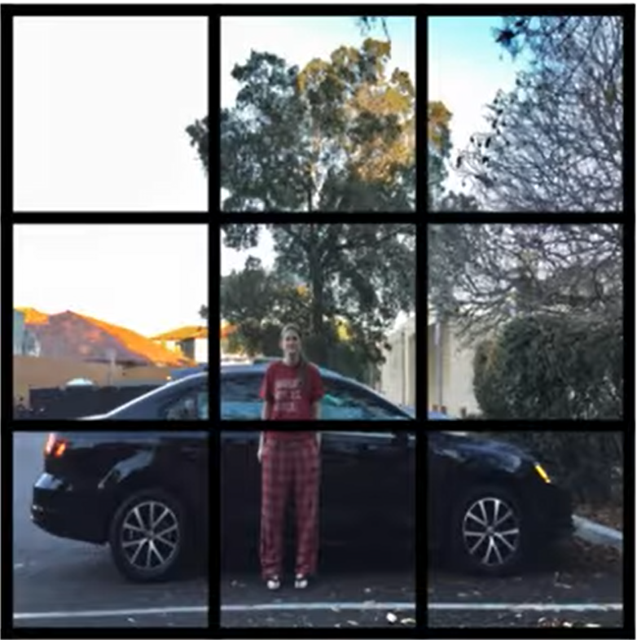
Localizing multiple objects
A cell contains midpoints of different objects
With previous labels we have to choose one
of the objects
Idea: extend the label in such a way that
more objects can be detected in a grid cell.
For each object potentially present in a cell
define a “shape” called anchor box
Add in the label the infos for each anchor box
If more objects are in the same cell, associate
the object to the anchor box more similar to
the object bounding box (you can use IoU
between object’s b.b. and a.b. as similarity)

Slide 22
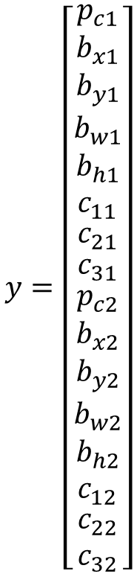
Localizing multiple objects
$$y=\left[\begin{matrix}p_{c1} \\ b_{x1} \\ \begin{matrix}b_{y1} \\ b_{w1} \\ \begin{matrix}b_{h1} \\ c_{11} \\ \begin{matrix}c_{21} \\ \begin{aligned}c_{31} \\ \begin{matrix}p_{c2} \\ b_{x2} \\ \begin{matrix}b_{y2} \\ b_{w2} \\ \begin{matrix}b_{h2} \\ c_{12} \\ \begin{matrix}c_{22} \\ c_{32}\end{matrix}\end{matrix}\end{matrix}\end{matrix}\end{aligned}\end{matrix}\end{matrix}\end{matrix}\end{matrix}\right]$$
anchor1
Anchor box 1
Anchor box 2
anchor2

Slide 23
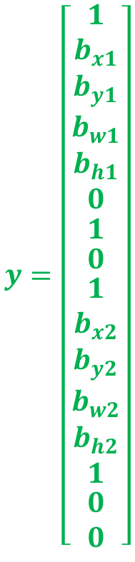
Localizing multiple objects
Both pedestrian (c₁) and car (c₂) are assigned
to green cell
Pedestrian assigned to anchor box 1
Car assigned to anchor box 2
$$y=\left[\begin{matrix}1 \\ b_{x1} \\ \begin{matrix}b_{y1} \\ b_{w1} \\ \begin{matrix}b_{h1} \\ 0 \\ \begin{matrix}1 \\ \begin{aligned}0 \\ \begin{matrix}1 \\ b_{x2} \\ \begin{matrix}b_{y2} \\ b_{w2} \\ \begin{matrix}b_{h2} \\ 1 \\ \begin{matrix}0 \\ 0\end{matrix}\end{matrix}\end{matrix}\end{matrix}\end{aligned}\end{matrix}\end{matrix}\end{matrix}\end{matrix}\right]$$
Anchor box 1
anchor1
Anchor box 2
anchor2

Slide 24
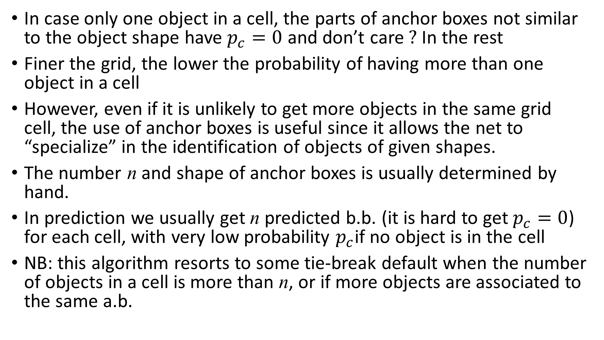
In case only one object in a cell, the parts of anchor boxes not similar to the object shape have $p_{c}=0$ and don’t care $?$ In the rest
Finer the grid, the lower the probability of having more than one object in a cell
However, even if it is unlikely to get more objects in the same grid cell, the use of anchor boxes is useful since it allows the net to “specialize” in the identification of objects of given shapes.
The number n and shape of anchor boxes is usually determined by hand.
In prediction we usually get n predicted b.b. (it is hard to get $p_{c}=0$) for each cell, with very low probability $p_{c}$if no object is in the cell
NB: this algorithm resorts to some tie-break default when the number of objects in a cell is more than n, or if more objects are associated to the same a.b.

Slide 25
Summing up

Slide 26
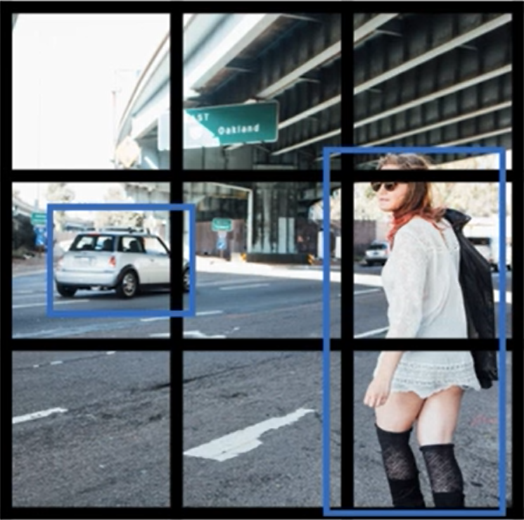
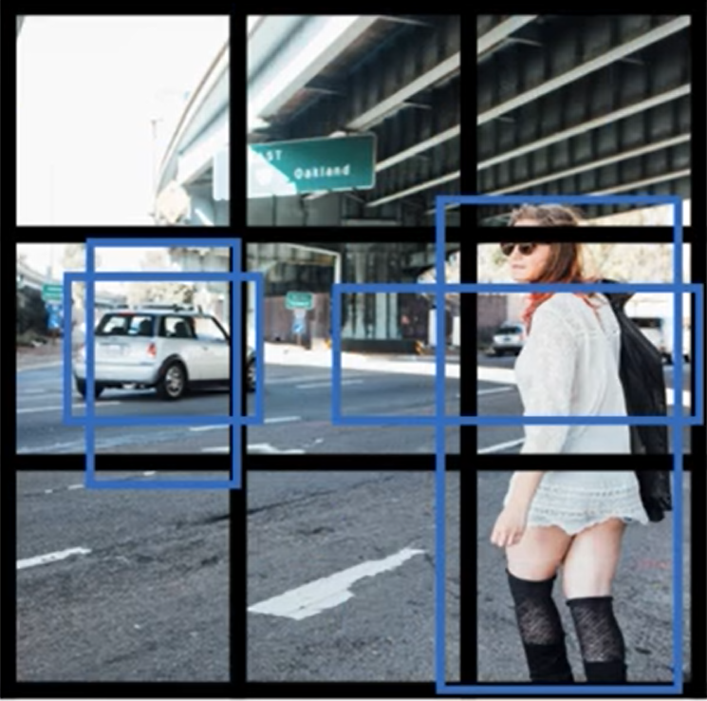
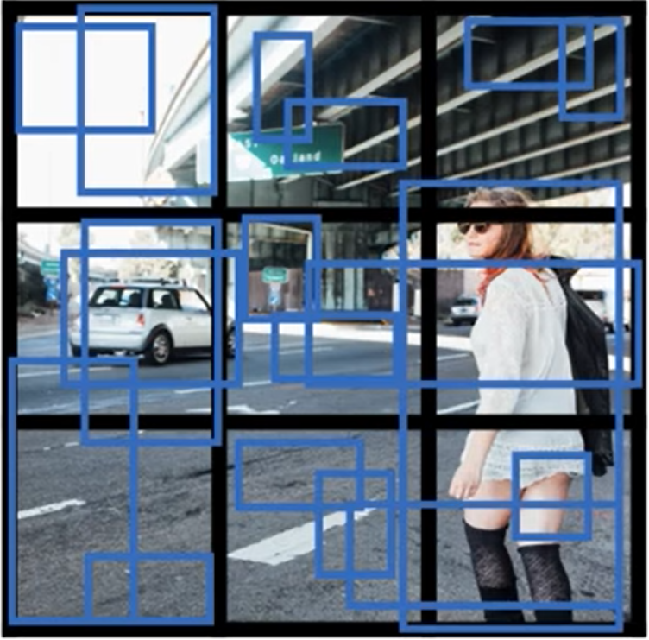
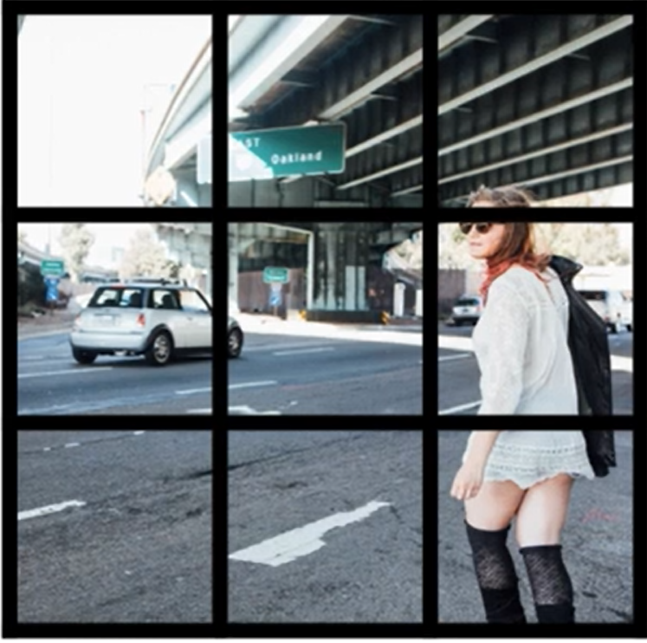
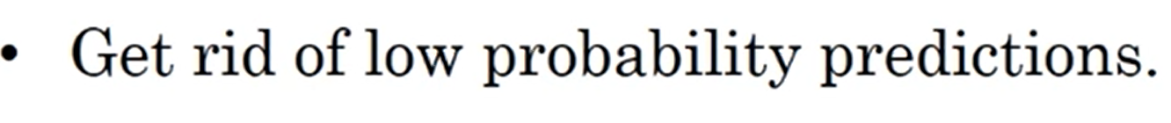

For each grid cell, get 2 predicted bounding boxes (2 anchor boxes)

